Slide 1


Capstone Project - The Battle of Neighborhoods – Toronto Presentation
SELECTING LOCATION TO OPEN A DELI/BODEGA RESTAURANT IN TORONTO

Slide 2

Introduction: Business Problem
Toronto is a diverse and cosmopolitan city in Canada with an excellent array of cuisine influenced by its immigrant history.
Deli restaurants are becoming popular and one is always popping up around the corner nearby. One needs to distinguish oneself from others to reap long-term success.
My client wants to expand its deli business into Toronto and is looking for appropriate locations in the city to begin its operations.

Slide 3
Data Acquisition & Cleaning
The data for this project was scraped from a Wikipedia page that contains the lists of boroughs, neighborhoods and postal codes.
The Python geocoder was used for the geolocations of neighborhoods with inputs of name plus city and country.
In order to obtain venues and their categories FOURSQUARE (https://foursquare.com/) was used.

Slide 4
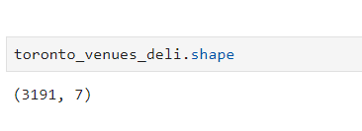
Data Selection
To find the characteristics of potential competitors’ venues in Toronto, we had to figure out the number of delis in the city and their locations.
Based on their postal codes we were successful in finding their geographic coordinates.
In Toronto, there are 3191 delis in currently in business.

Slide 5
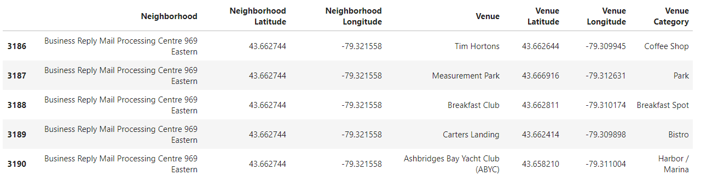
Data Selection
Geographic coordinates of 5 deli locations for the deli restaurant.

Slide 6
Methodology
Addresses were converted into their equivalent latitude and longitude values.
Foursquare API was used to explore neighborhoods in the city with part of their names being Toronto.
After that, explore function was used to get deli restaurant categories in each neighborhood.

Slide 7
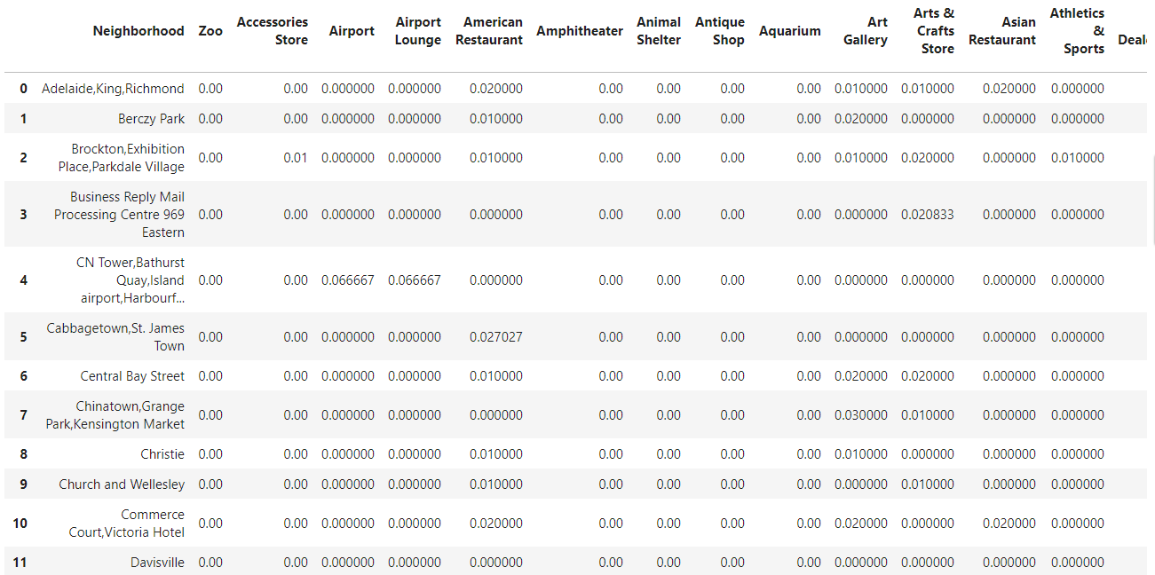
Methodology

Slide 8
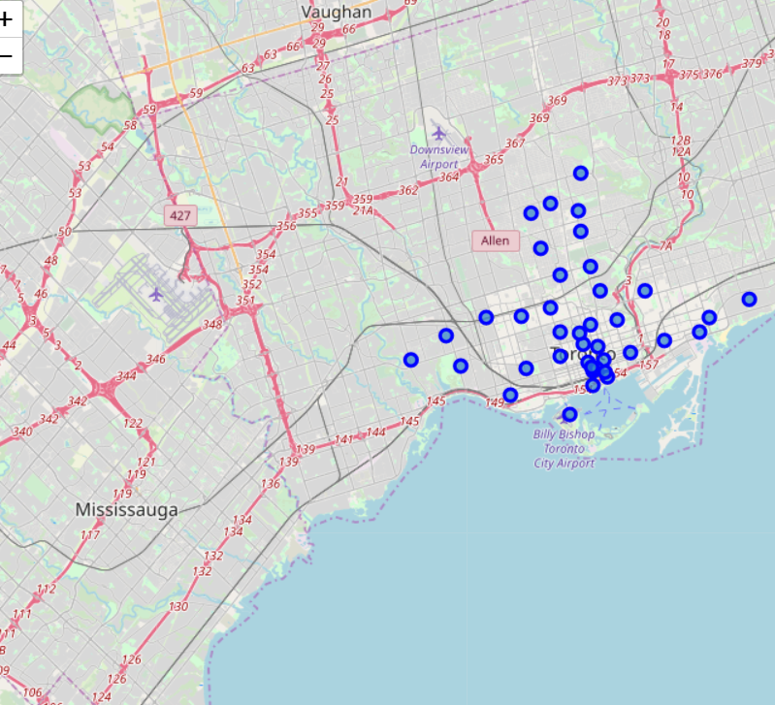
Methodology
Delis in Toronto

Slide 9
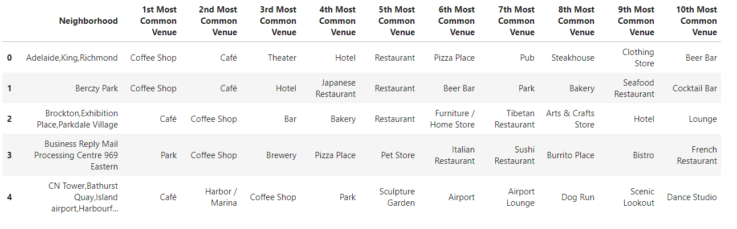
Methodology
The feature was used to group the neighborhoods into clusters using K-means clustering algorithm. The Folium library helped to visualize the neighborhoods in Toronto and its emerging clusters.

Slide 10
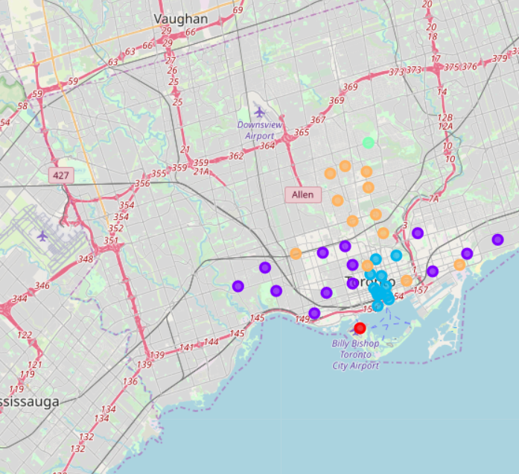
Results
After running the K-means clustering we accessed each cluster created to see which neighborhoods were assigned to each of the five clusters. Visualized the clustered neighborhoods on a map using folium library.
Each cluster is color coded; we can see that majority of the neighborhood falls in the purple cluster (cluster 2) followed by yellow (cluster 5) and blue (cluster 3). Cluster 1 (red) and cluster 4 (green) are next.

Slide 11
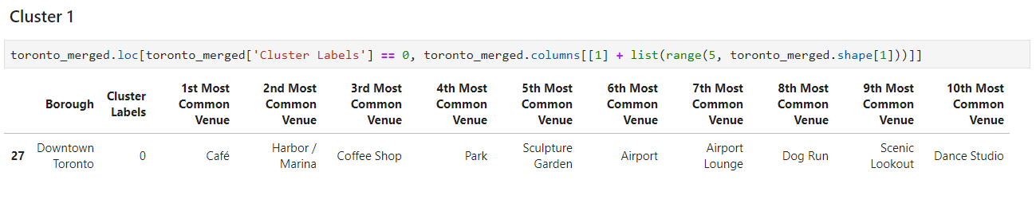
Result
Cluster 1

Slide 12
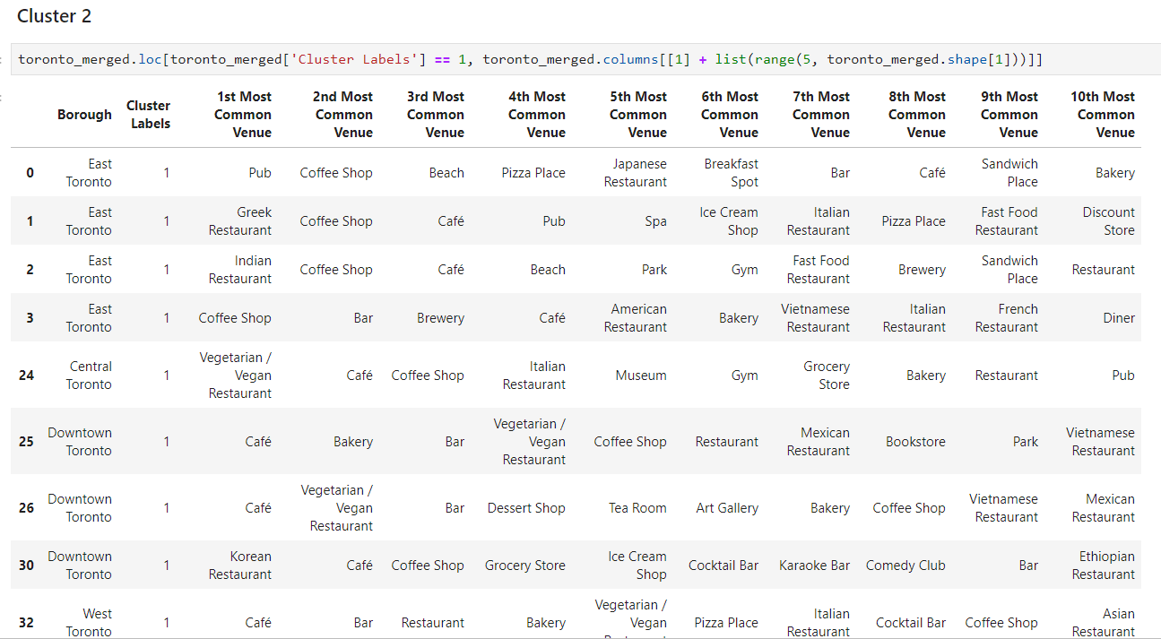
Result
Cluster 2

Slide 13
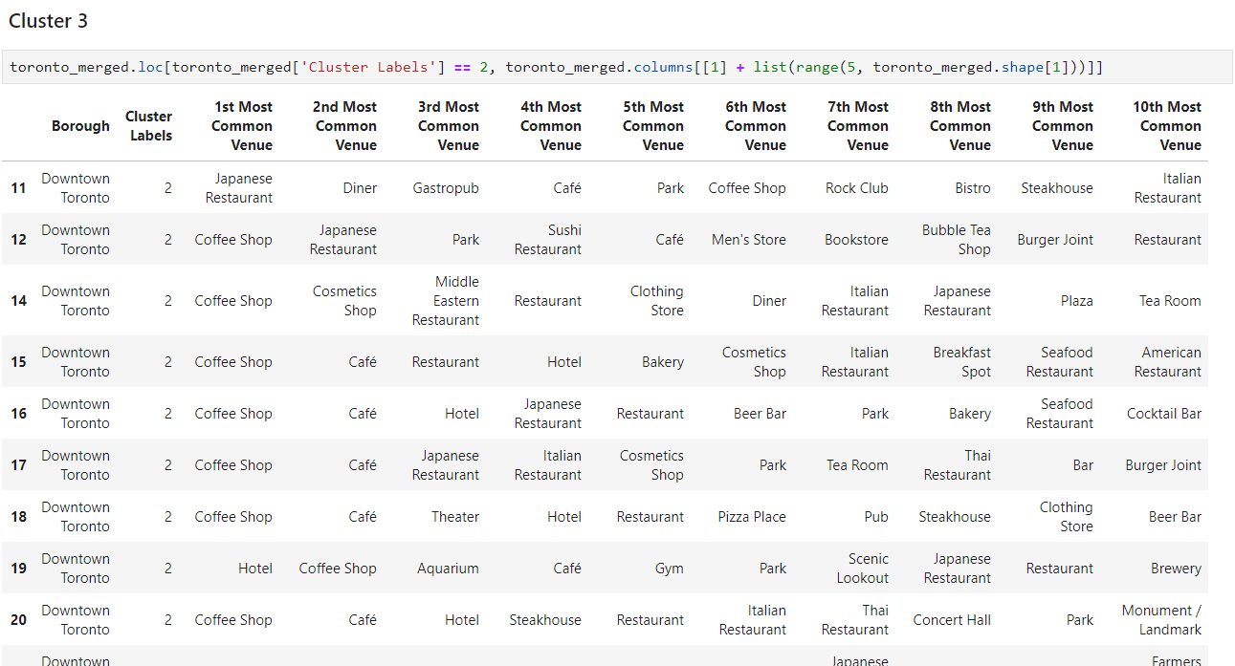
Result
Cluster 3

Slide 14
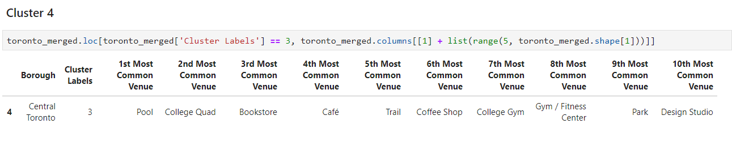
Result
Cluster 4

Slide 15
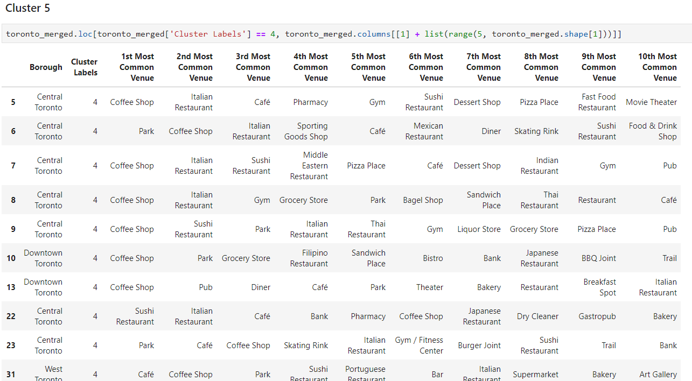
Result
Cluster 5

Slide 16
Discussion
The aim of this project was to help a deli business trying to open new restaurants in Toronto find the best locations to set up in order to maximize their return on investments.
It was observed that both Clusters 1 (Downtown Toronto) and 4 (Central Toronto) did not have a lot of deli places and hence it would be worthwhile on the part of the company to set up their restaurants in those places.
Clusters 2, 3 and 5 seem to be places of extremely high competition among deli businesses and hence would be risky to open the business from there.

Slide 17

Conclusion
The goals of the project were met and with some additional work can be developed to support the opening of a deli restaurant in an unknown location in a city.
The future of this project includes taking other factors such as the cost of living in that cluster into consideration in order to recommend an area for opening the deli business.

